Slide 1
电子电路基础
第三讲：电路分析的基本方法和定理~part2

Slide 2
电路分析的基本方法和定理
2
1.3.1 电容和电感（原理、符号及其特性定量描述）
2.4 储能元件电路的等效变换
2.4.1 电容的串联和并联
2.4.2 电感的串联和并联

Slide 3
Capacitors and Inductors Chapter 6
3
电容、电感，及它们的串并联
6.1 Capacitors 电容
6.2 Series and Parallel Capacitors
6.3 Inductors 电感
6.4 Series and Parallel Inductors

Slide 4
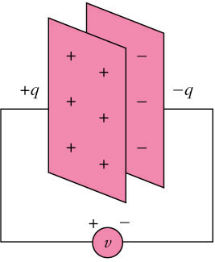
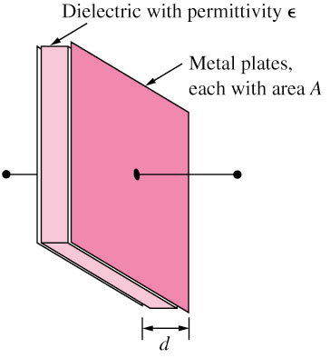
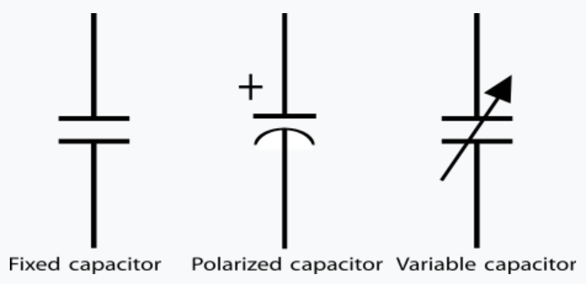
6.1 Capacitors 电容
4
A capacitor is a passive (无源) element designed to store energy in its electric field. 储存电场能量
A capacitor consists of two conducting plates separated by an insulator (or dielectric).

Slide 5
5
Through-hole
直插式电容
SMD
(surface mount device)
贴片电容

Slide 6
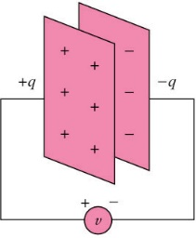
6.1 Capacitors (2)
6
电容的定义：导板上的电荷和导板之间电势差的比值
Capacitance C is the ratio of the charge q on one plate of a capacitor to the voltage difference v between the two plates, measured in farads (F).
介电常数
平板面积
and
平板间距离
平板上的电荷量
电压
Where ε is the permittivity of the dielectric material between the plates, A is the surface area of each plate, d is the distance between the plates.
Unit: F, pF (10^{–12}), nF (10^{–9}), and
μF (10^{–6})

Slide 7
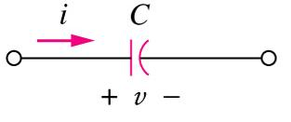
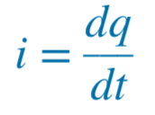
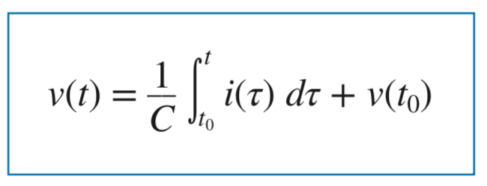
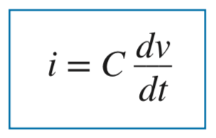

6.1 Capacitors (3)
7
If i is flowing into the +v terminal of C
  电流从+端流入→ 充电Charging
  电流从+端流出→ 放电Discharging
电容也是基本的电路元件，我们需要熟悉流过它的电流和它两端电压之间的关系，就如熟悉电阻一样。The current-voltage relationship of capacitor according to above convention is ：电容的“电压-电流”关系

Slide 8
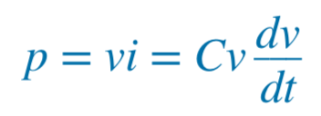
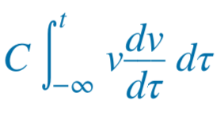
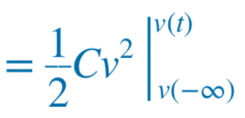
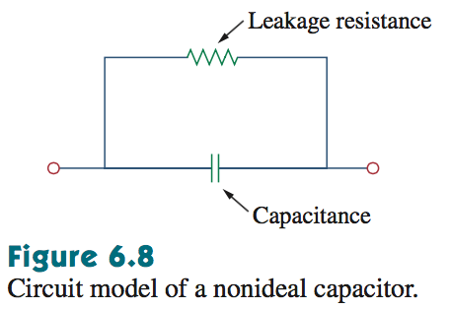

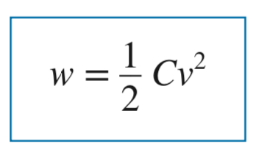
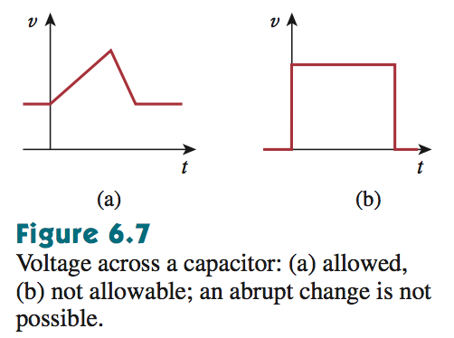
6.1 Capacitors (4)
8
The energy, w, stored in the capacitor is (电容存储的电能)：
电容的两个基本属性
  an open circuit to dc (dv/dt = 0). 直流开路
  its voltage cannot change abruptly. 电容两端电压不能突变，Why？
√
×

Slide 9
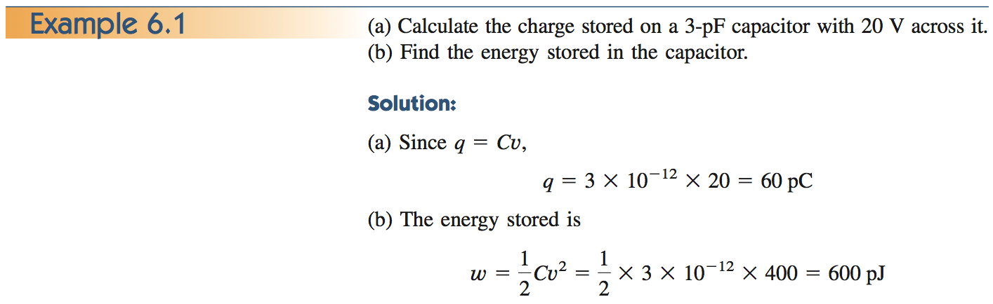
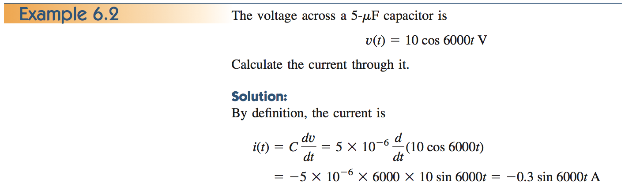
9

Slide 10
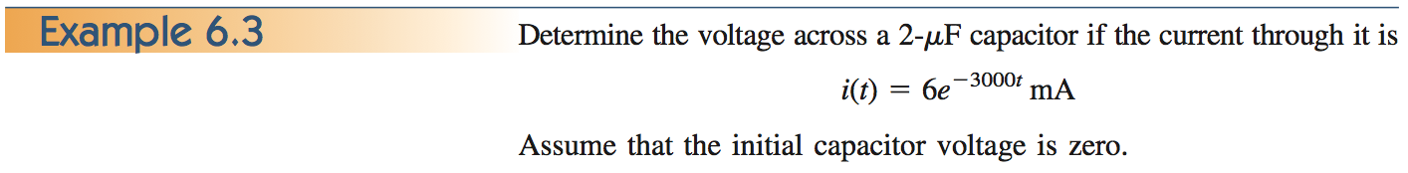
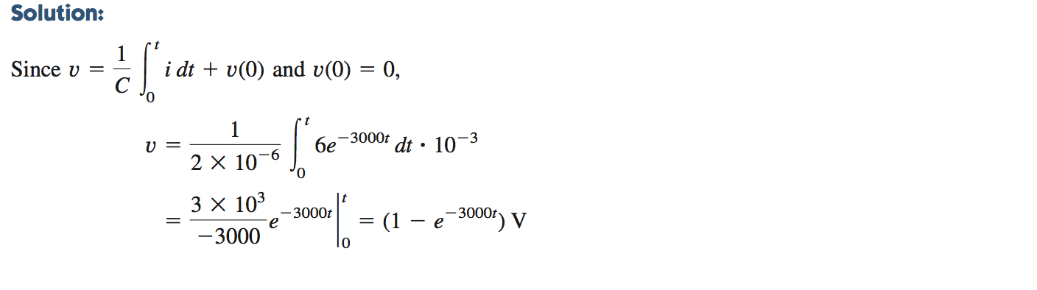
10

Slide 11
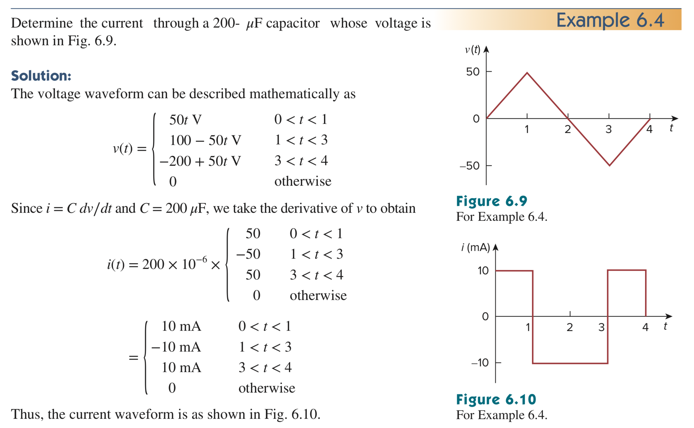
11

Slide 12
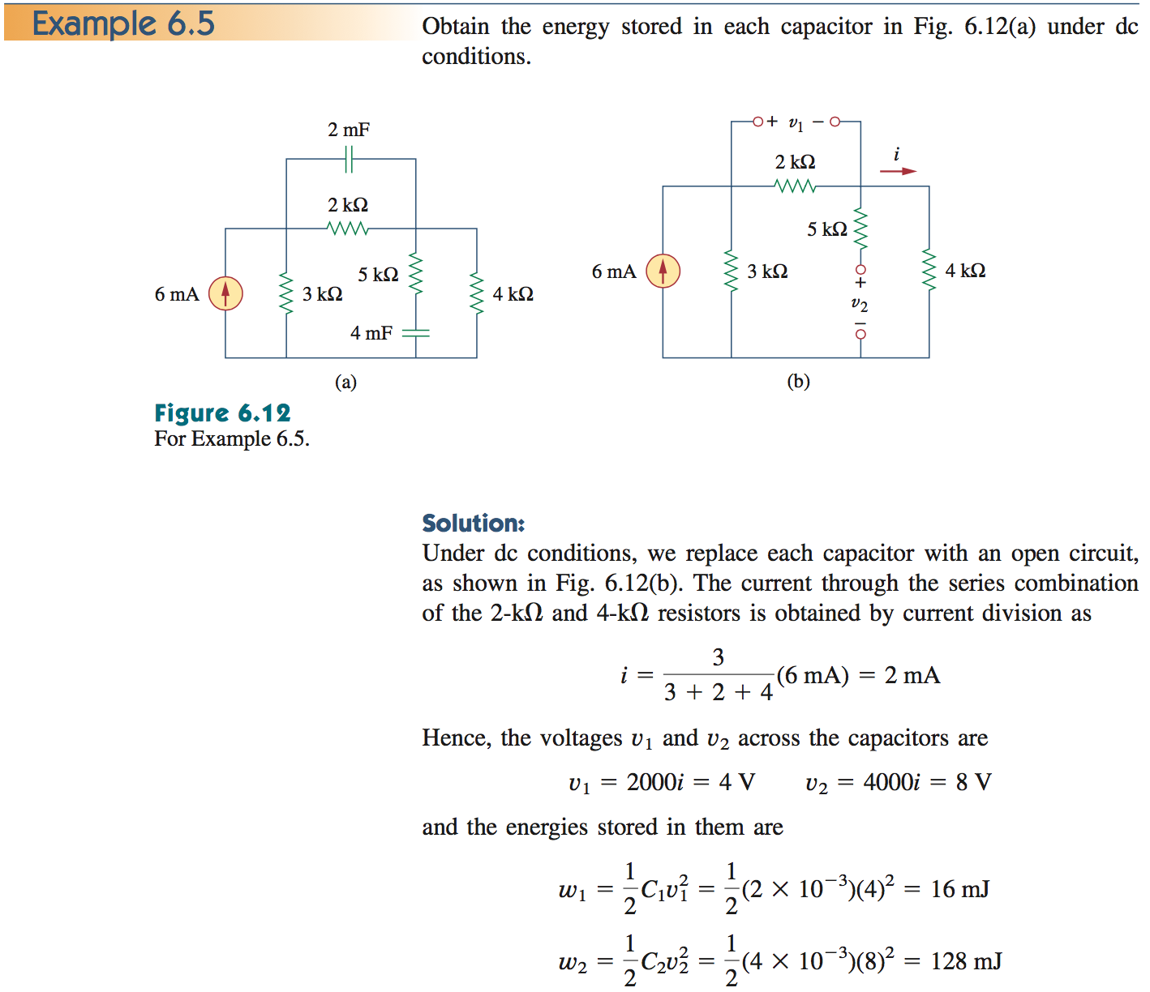
12
电容：直流开路

Slide 13
电容的模型
C
＋
i
＋
－
R
v
C
考虑漏电时的电容器模型
L
C
－
＋
－
R
理想电容器模型
高频时的电容器模型

Slide 14
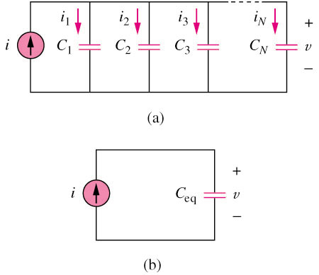
6.2 Series and Parallel
Capacitors (1)
14
The equivalent capacitance of N parallel-connected capacitors is the sum of the individual capacitances.
电容并联：
电压相等，电流相加 → C相加

Slide 15
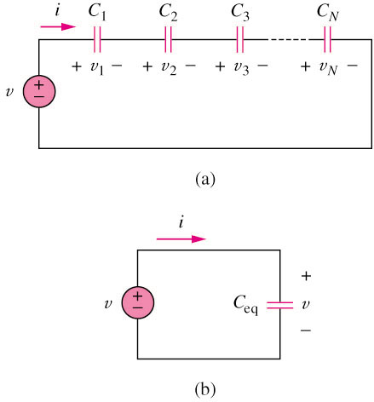
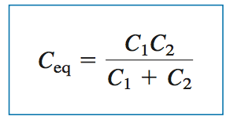
6.2 Series and Parallel
Capacitors (2)
15
The equivalent capacitance of N series-connected capacitors is the reciprocal of the sum of the reciprocals of the individual capacitances.
若N=2：
电容串联：
电流相等，电压相加 →1/C相加 → 类似于电阻并联

Slide 16
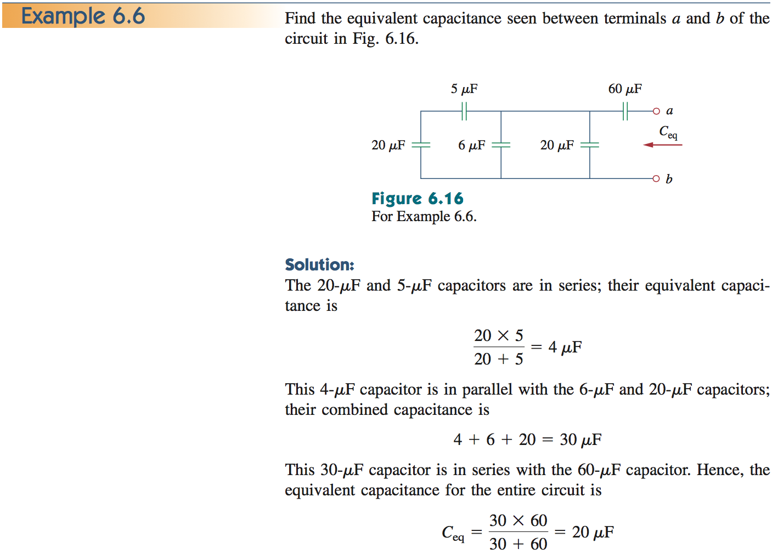
16

Slide 17
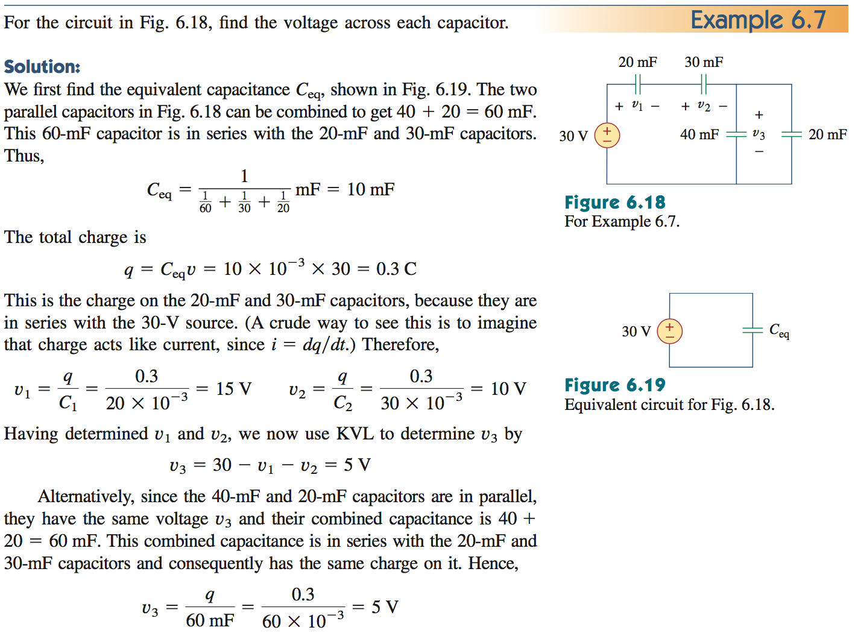
17
串联电容的q相等
Q=CV, V之比等于1/C之比

Slide 18
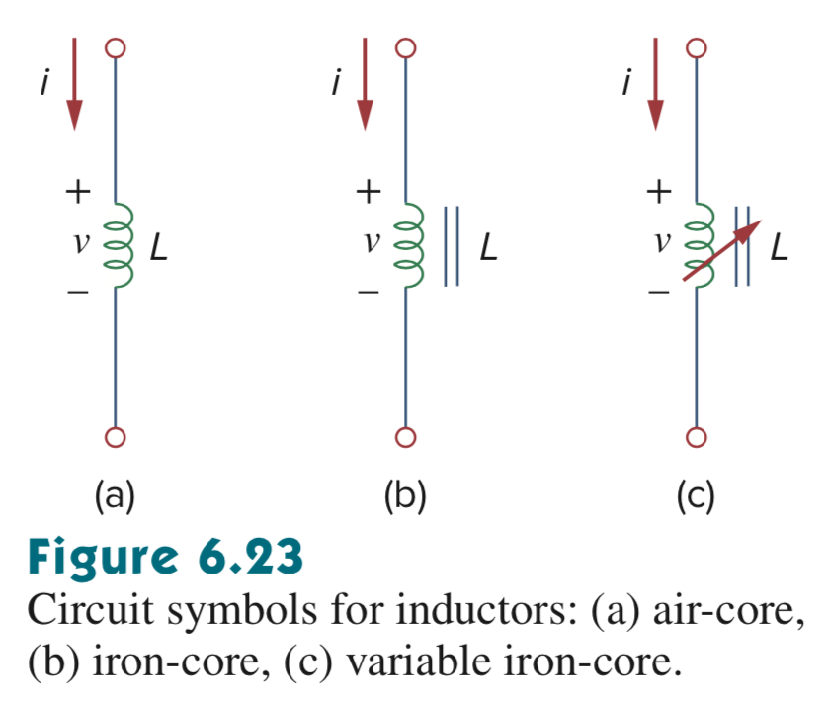
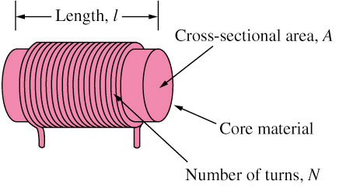
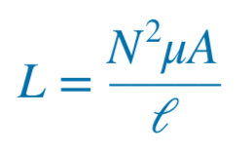
6.3 Inductors 电感
18
An inductor is a passive element designed to store energy in its magnetic field. 储存磁能
An inductor consists of a coil of conducting wire.
磁导率

Slide 19
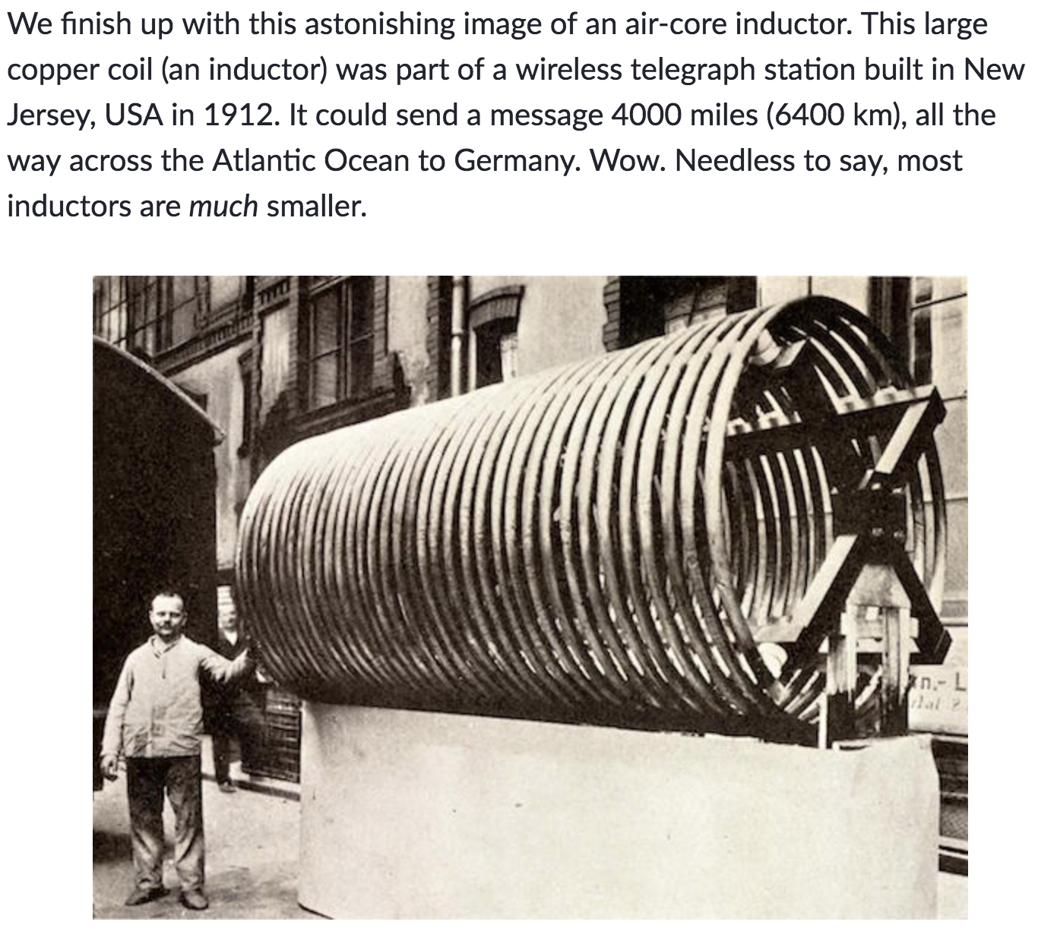
19

Slide 20
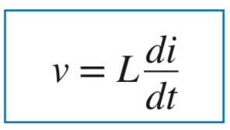
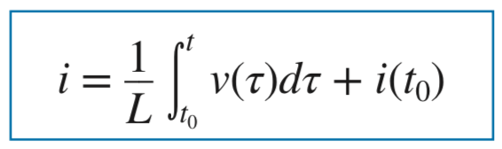
6.3 Inductors (2)
20
电感也是基本的电路元件，我们需要熟悉流过它的电流和它两端电压之间的关系，就如熟悉电阻一样。 电感的“电压-电流”关系：
The unit of inductors is Henry (H), mH (10^{–3}) and μH (10^{–6}).

Slide 21
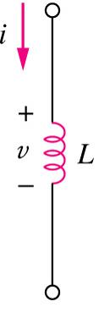
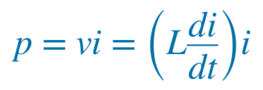
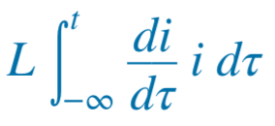
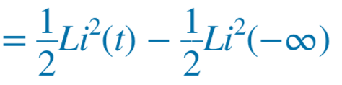

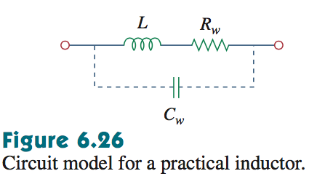
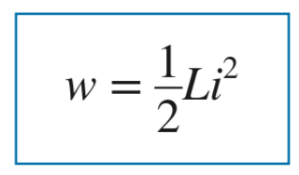
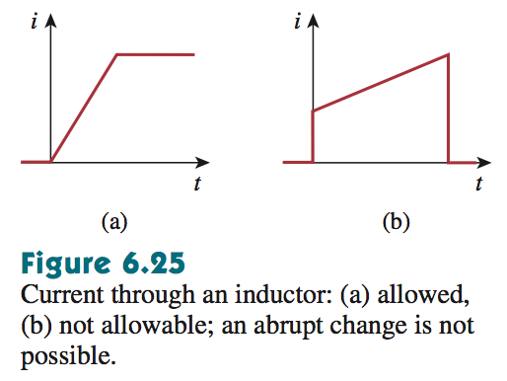

6.3 Inductors (3)
21
The power stored by an inductor:
电感的两个基本属性：
①直流短路(di/dt = 0) ；②电流不能突变，Why？
√
×

Slide 22
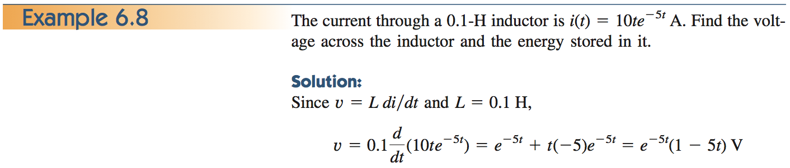
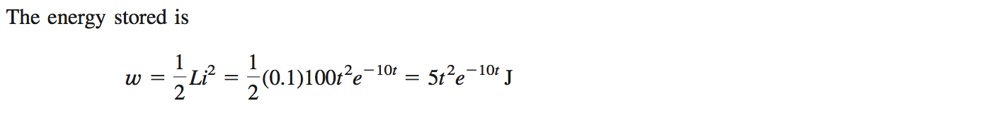
22

Slide 23
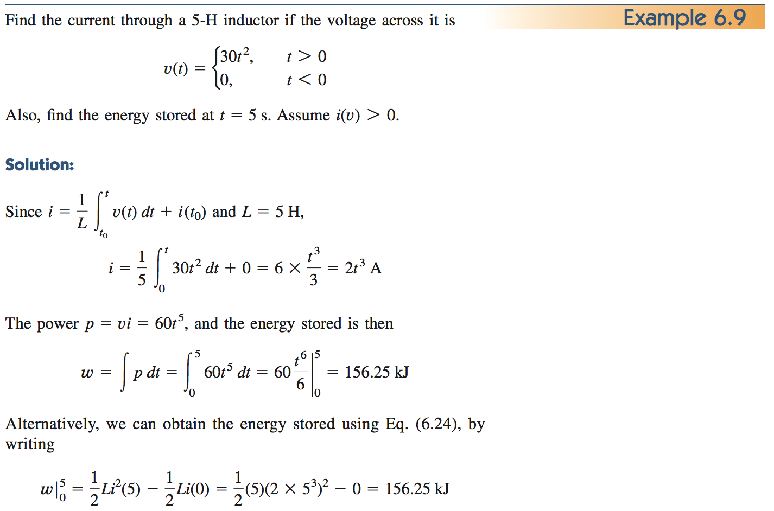
23

Slide 24
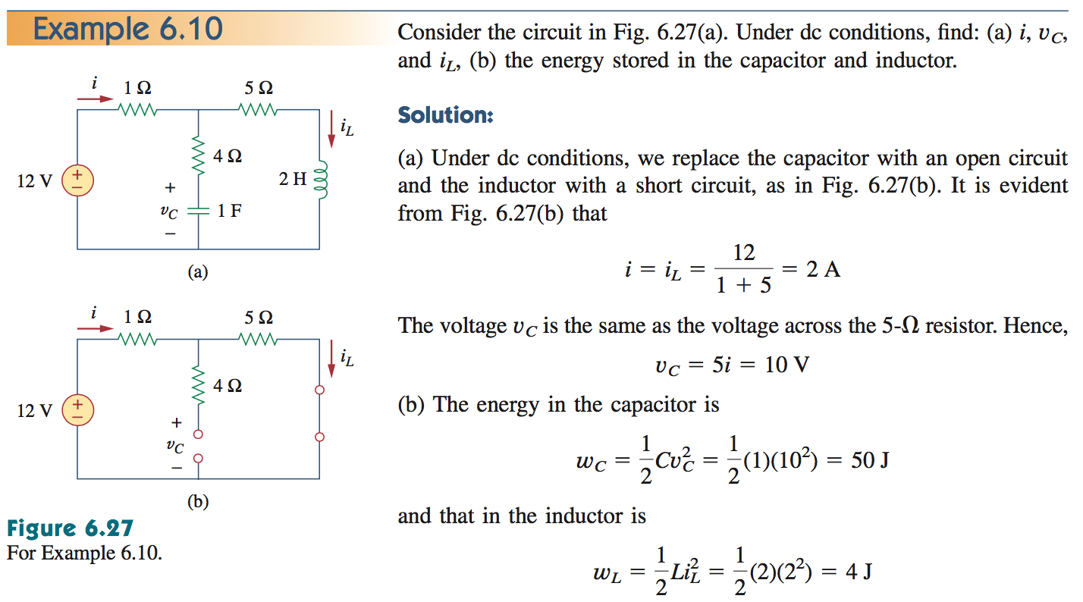
24
电容直流开路；电感直流短路

Slide 25
电感的模型
i
L
+
v (t)
－
L
R
理想电感
C
＋
v(t)
－
i
R
L
工作频率很高的情况
＋
v(t)
－
考虑内阻

Slide 26
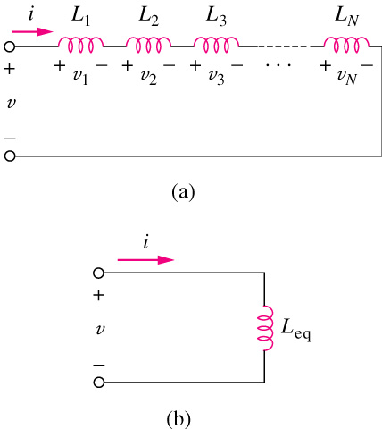
6.4 Series and Parallel
Inductors (1)
26
The equivalent inductance of series-connected inductors is the sum of the individual inductances.
电感串联：
电流相等，电压相加 → L相加

Slide 27
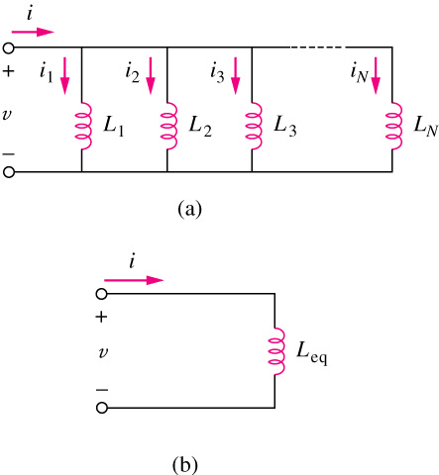

6.4 Series and Parallel
Inductors (2)
27
The equivalent capacitance of parallel inductors is the reciprocal of the sum of the reciprocals of the individual inductances.
若N=2：
电感并联：
电压相等，电流相加 → 1/L 相加
电感的串并联与电阻器的电阻值计算一样！

Slide 28
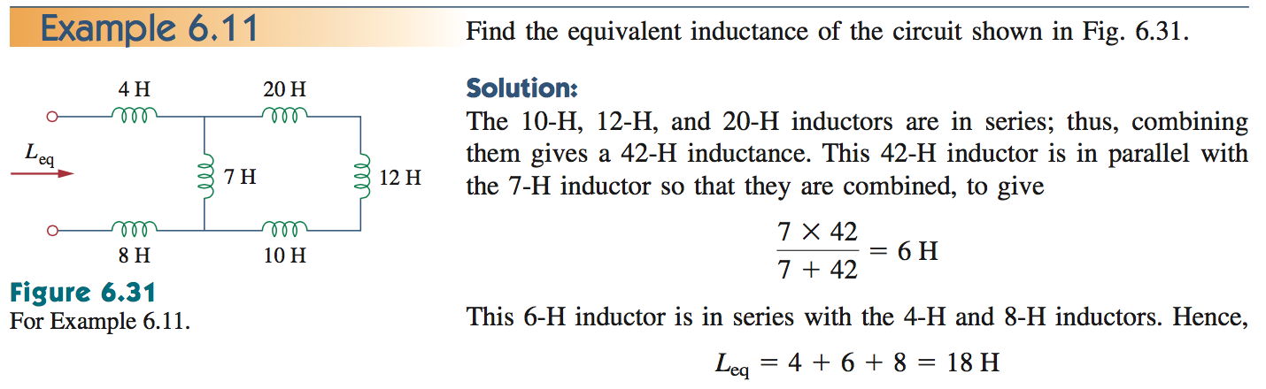
28

Slide 29
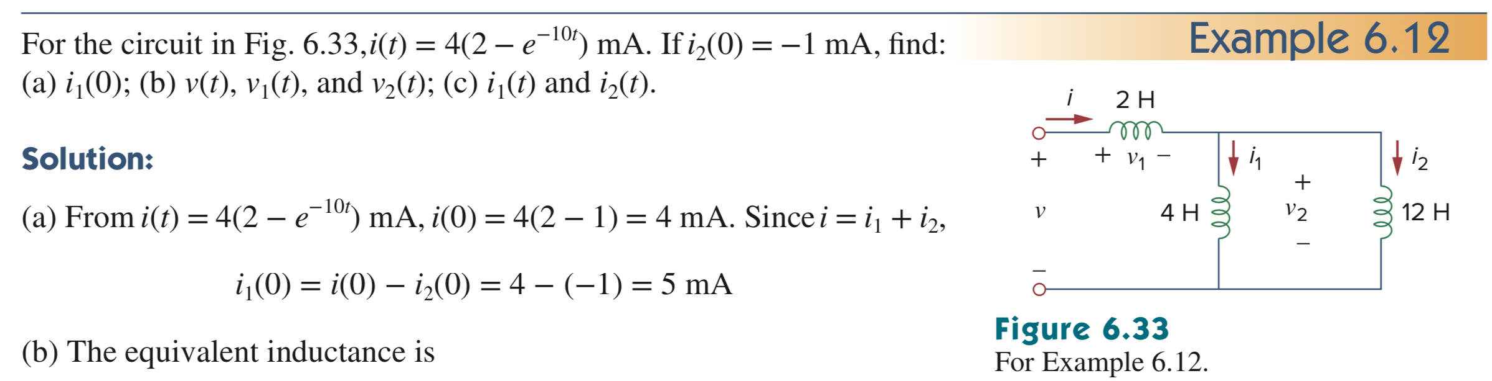
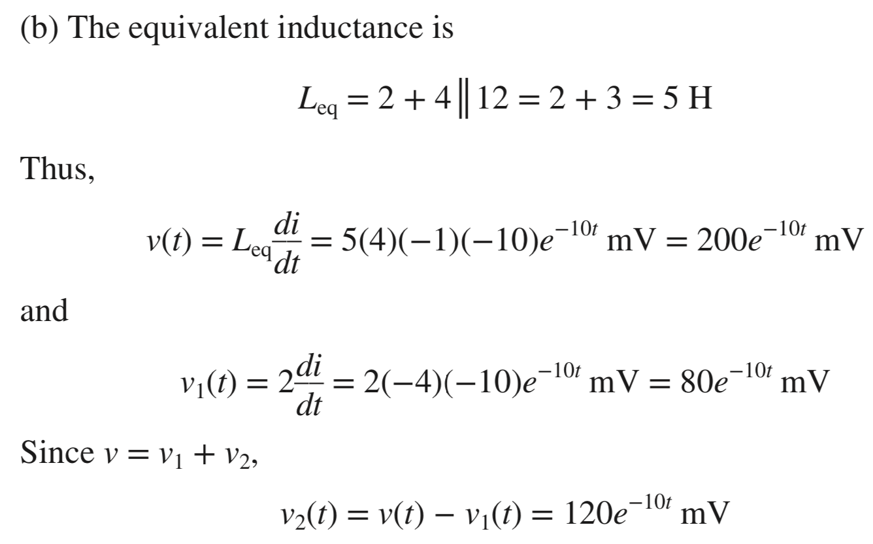
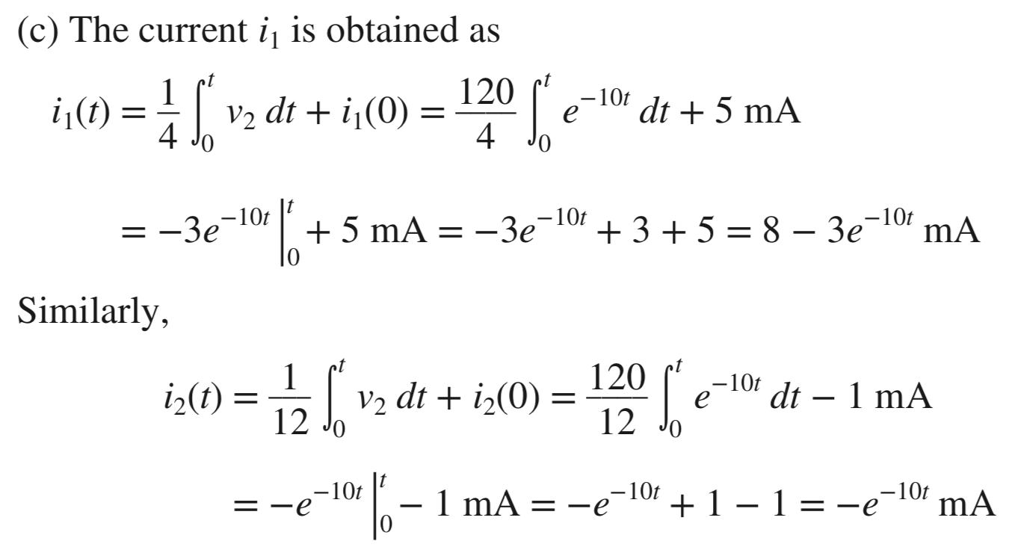
29
电感：根据电压求电流，需要先求出各电感的初始电流值
i₂(t) 也可以用i – i₁(t) 获得

Slide 30
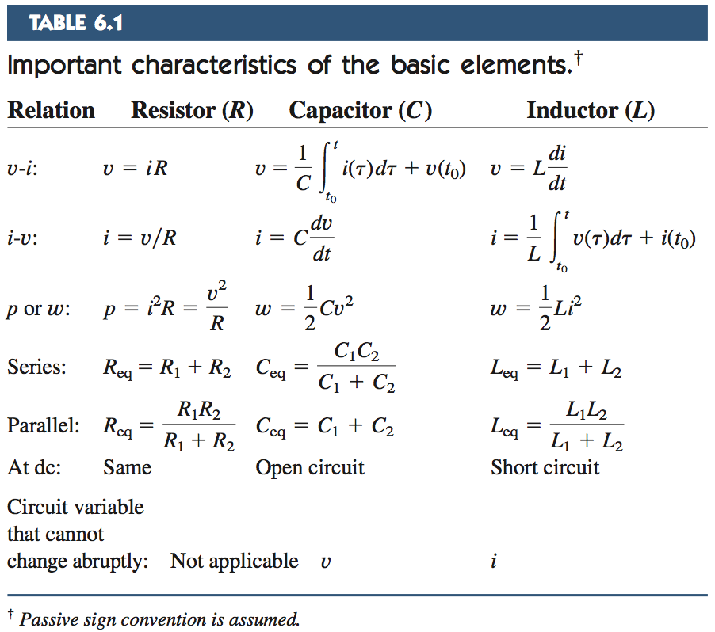
30

Slide 31
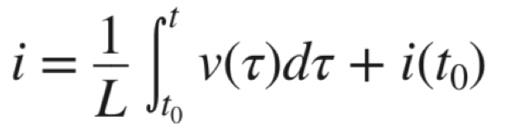
小结
31
电感：直流短路，流过电感的电流不能突变
电容并联：C相加；电容串联：相当于电阻并联；
电感的串并联相当于电阻的串并联
电容，根据电流求电压，需要先求电容两端电压的初始值；
电感，根据电压求电流，需要先求流过电感的电流初始值；

Slide 32
作业
32

Slide 33

电容串并联；串联电容的q相等

Slide 34

电容直流开路；电感直流短路

